Slide 1
worded Problems
EQ: write your own worded problem and solve it.

Slide 2
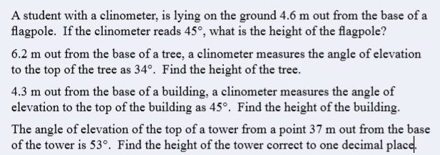

Slide 3
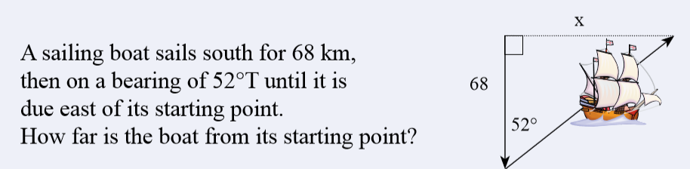

Slide 4
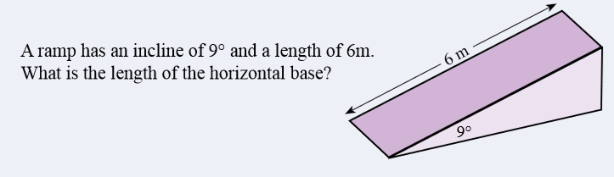
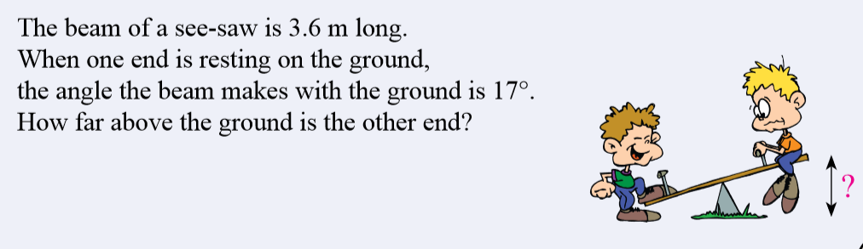

Slide 5
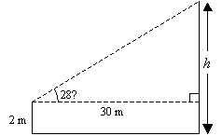
Example:
A man who is 2 m tall stands on horizontal ground 30 m from a tree. The angle from the top of the tree from his eyes is 28˚. Estimate the height of the tree.
Step 1 – sketch a diagram.
Caution: don’t forget to add the 2m height of the man at the height of the tree.

Slide 6
Worded Problems
EQ: Write your own worded problem and solve it.
From the top of a vertical cliff, the angle of a ship on the surface of the ocean level with the base of the cliff is 34º. The ship is 60m away from the cliff. How high is the cliff?
Brian’s kite is flying above a field at the end of 65 m of string. If the angle between the kite and the ground is 70°, how high is the kite above Brian’s head?

Slide 7
11. Standing on a cliff 380 meters above the sea, Pat sees an approaching ship and measures its angle, obtaining 9 degrees between the ship and the ocean. How far from shore is the ship? Now Pat sights a second ship beyond the first. The angle of the second ship is 5 degrees from the ship to the ocean. How far apart are the ships?

